Slide 1
Empowering Digital Transformation at BeGop
BeGop Software Solutions is a forward-thinking IT services company specializing in delivering innovative digital transformation solutions using Salesforce, Snowflake, and Tableau. We empower businesses by integrating these cutting-edge technologies to streamline operations, enhance customer relationships, and unlock actionable insights from data.
Mohamed Azarudeen
Presenter

Slide 2
Innovative Technology Partnership
Your Trusted Partner in Transformative Digital Solutions
Who We Are
Our Client Trust
Optimizing Operations
Streamlining Data Processes
Accelerating Growth
We are a forward-thinking technology partner, specializing in Salesforce, Snowflake, Tableau, Netsuite, Boomi and Digital Marketing.
Trusted by clients across the world, we deliver transformative digital solutions tailored to their needs.
We focus on optimizing operations for businesses to enhance efficiency and productivity.
Expertise in streamlining data processes ensures clients can access data seamlessly.
Our solutions are designed to accelerate growth, helping businesses scale rapidly.

Slide 3
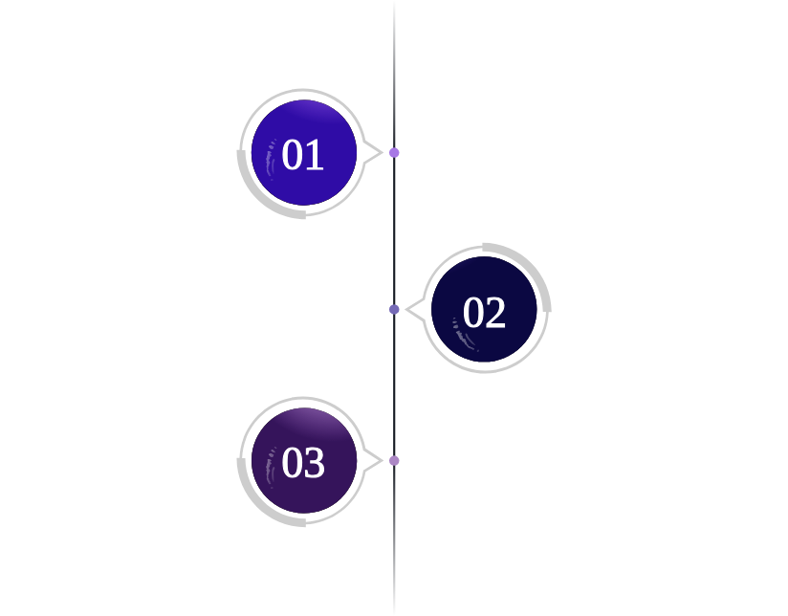
Our Commitment to Excellence
Driving success through collaboration and innovation
Success driven by technology
We leverage cutting-edge technology to enhance client solutions and drive success.
Partnership at every stage
We collaborate closely with clients throughout their digital journey to ensure optimal outcomes.
Focus on quality and transparency
Our operations are built on a foundation of quality, transparency, and accountability in all interactions.

Slide 4
Expertise in Salesforce Solutions
Design and Implementation of CRM
Automation and Advanced Analytics
360° Customer Interaction View
Focus on creating and customizing effective CRM solutions for diverse business needs.
Utilize automation tools and analytics to enhance efficiency and insights in customer relationships.
Provide clients with a unified view of all customer interactions to improve service and engagement.

Slide 5
Expertise in Snowflake Data Solutions
Delivering Scalable and Actionable Data Insights
Data Integration Specialists
Unified Data Repository
We excel in designing robust data integration solutions that streamline the flow of information across systems.
Our solutions consolidate various data sources, creating a single, actionable repository for informed decision-making.
Real-Time Insights
Scalable Performance
We enable real-time analytics, allowing organizations to derive insights swiftly and adapt to market changes.
Our architecture supports scalability, ensuring performance can grow with your enterprise's needs.
Comprehensive Analytics
Visual Data Pipelines
We provide advanced analytics capabilities, empowering businesses to uncover trends and optimize operations.
We utilize visual tools to represent data pipelines, enhancing understanding and management of data workflows.

Slide 6
Expertise in Tableau Visualization
Harnessing the Power of Tableau for Business Insights
Transforming Data into Insight
Customized Dashboards Creation
Actionable Insights for Decision-Making
Sample Dashboards and Visual Elements
01
02
03
04
Tableau empowers users to convert complex data sets into compelling visual narratives, enhancing understanding.
Develop tailor-made dashboards and interactive reports that cater to the specific needs of various stakeholders.
Equip stakeholders with actionable insights that facilitate informed decision-making and strategic planning.
Showcase examples of dashboards and data visualization elements that illustrate Tableau's powerful capabilities.

Slide 7
Digital Marketing Strategies
Driving Brand Awareness & Revenue Growth
Google Ads Campaigns
Strategically designed ads that target specific audiences to significantly boost brand visibility and drive conversions.
Integrated Strategies
Social Media Marketing
Combine various digital channels into a cohesive marketing strategy that drives sustainable revenue growth.
Utilize platforms like Facebook, Instagram, and LinkedIn to amplify brand engagement and raise awareness effectively.
Analytics-Driven Optimization
Employ data insights to continuously refine marketing campaigns, ensuring maximized return on investment (ROI).

Slide 8
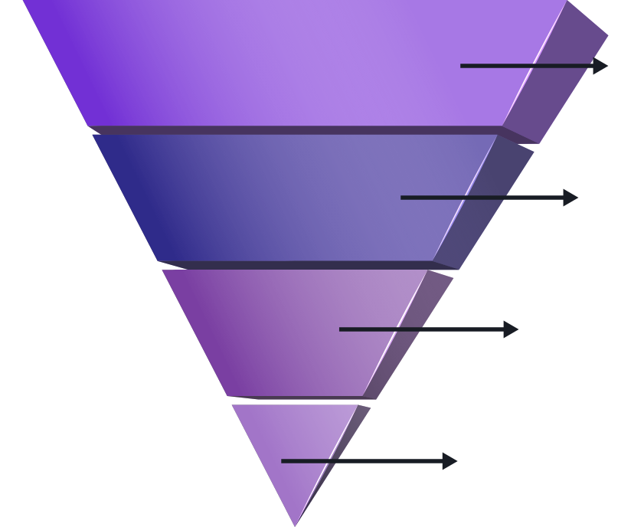
Netsuite Integration Solutions
Expert Implementation
Tailor Netsuite cloud ERP solutions to streamline your business processes effectively.
Seamless Integration
Effortlessly integrate Netsuite with existing digital platforms for unified operations.
Operational Efficiency
Enhance financial management, inventory control, and supply chain operations significantly.
Real-Time Insights
Utilize automated reporting and analytics to empower strategic decision-making.

Slide 9
Boomi Integration Solutions Simplified
Transforming Business Processes with Boomi
Efficient Data Connectivity
Low-Code Development
Scalability & Flexibility
Real-Time Synchronization
Proven Success
Boomi seamlessly connects cloud and on-premises apps, enhancing operational efficiency.
Rapid integration with minimal coding simplifies processes and accelerates deployment.
Boomi is designed to grow with your business, addressing diverse integration needs.
Immediate data sharing supports informed decisions, enhancing responsiveness.
Many industry leaders trust Boomi to streamline processes and drive transformation.

Slide 10
The BeGop Advantage: Elevating Solutions
Discover the Unique Benefits of Partnering with BeGop
Client-Centric Approach
01
We prioritize your needs, ensuring tailored solutions through active collaboration.
Strong Minds & Proven Expertise
Our team consists of seasoned professionals and innovators, delivering trusted expertise.
02
Innovation & Scalability
03
Our solutions are designed to grow with you, adapting to changing business landscapes.
Commitment to Quality & Trust
We employ rigorously tested processes that have established our reputation among leading clients.
04

Slide 11
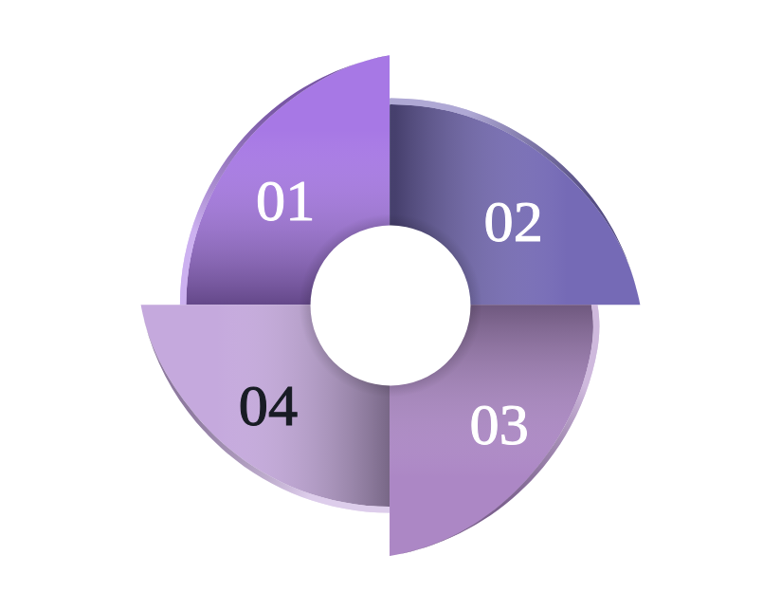
Branding & Visual Identity Essentials
Key elements defining our brand's visual presence
Consistent Logo Usage
The BeGop logo is prominently featured in branding color #92278F across all materials.
Modern Design Aesthetic
Our design approach is modern, clean, and professional, appealing to a contemporary audience.
Branded Material Examples
Examples of branded materials include business cards and website headers showcasing our identity.
Supportive Imagery
We utilize supportive imagery and icons that enhance our brand messaging and visual storytelling.

Slide 12
Elevate Your Business Today
Take the Next Steps Towards a Digital Transformation
Let’s Build Your Digital Future
Comprehensive Suite of Solutions
Expert Team Consultation
Transform Data into Assets
Engage with Us
Reach out today for a consultation and take the first step towards transformation.
Join us in shaping a more innovative and efficient digital landscape.
Explore our extensive range of services designed to boost your business performance.
Connect with our specialists for personalized strategies tailored to your needs.
Leverage your data and customer insights to drive strategic decision-making.

Slide 13
Gratitude
Thank You for Your Partnership and Support
We sincerely appreciate your interest and support. We are excited about the potential of working together and achieving great results. Please feel free to reach out via the contact information provided below.
admin@begopsolutions.com

